Slide 1

Exploratory Data Analysis Project (Group 3- 10alytics)
Group Members
Adegboyega Idowu Ashamu
Ogunfuyi Taiwo
Damilola Omosaiye
Charles Mayaki
Idongesit Essien
July 2022

Slide 2

Executive Summary
Exploratory Data Analytics and Visualization.
Problem statement.
This project objective is to apply our exploratory data analysis tools to predict if the bank’s customers after being contacted multiple times via direct marketing, i.e. mostly phone calls, would be open to subscribing to a term loan.
We would be using different criteria to evaluate clients, which include:
Credit history.
Job.
Education.
Marital status
Age.
Existing loan.

Slide 3
Data Description
The bank marketing data set was uploaded originally to the UCI Machine Learning Repository. The data set gives us information about a financial institution's marketing campaign, which we are analysing to find ways to look for strategies to improve future campaigns for the bank.
The dataset was made up of 45211 entries which has 17 columns were discovered in the dataset 7 of which are Int data types and 10 of the columns objects
There were no missing data in the data set
Job and Month has the highest categorical values
Key discoveries
Client with job type as management and blue-collar records are high in the given dataset whereas jobs like housemaid and student are very less
Clients who married are high in records while those divorced are less
Clients whose educational background is secondary are highest
Data in the month of may is highest while least in Dec
Clients who have housing loan seem not to be interested in the deposit
In the month of may, records are high but clients’ interest ratio is very less
Column Names
Age, Job, Marital , Education, default , balance, housing, loan, contact, day, month, duration, campaign, 'pdays', 'previous', 'poutcome’, and ‘ Y’ which we renamed to ‘deposit’

Slide 4
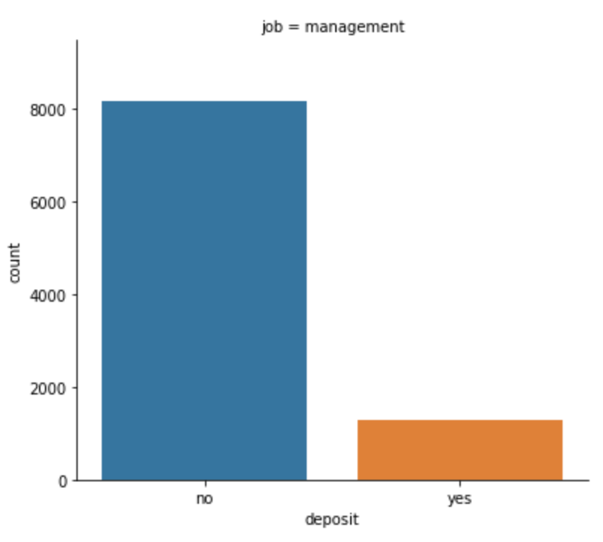
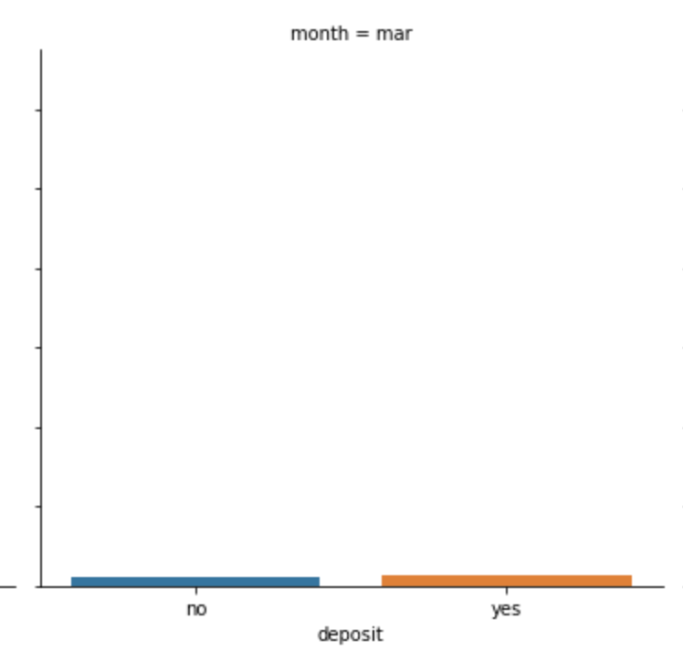
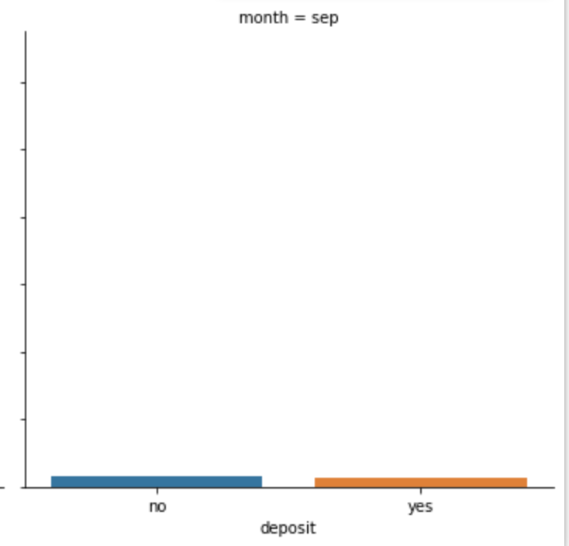
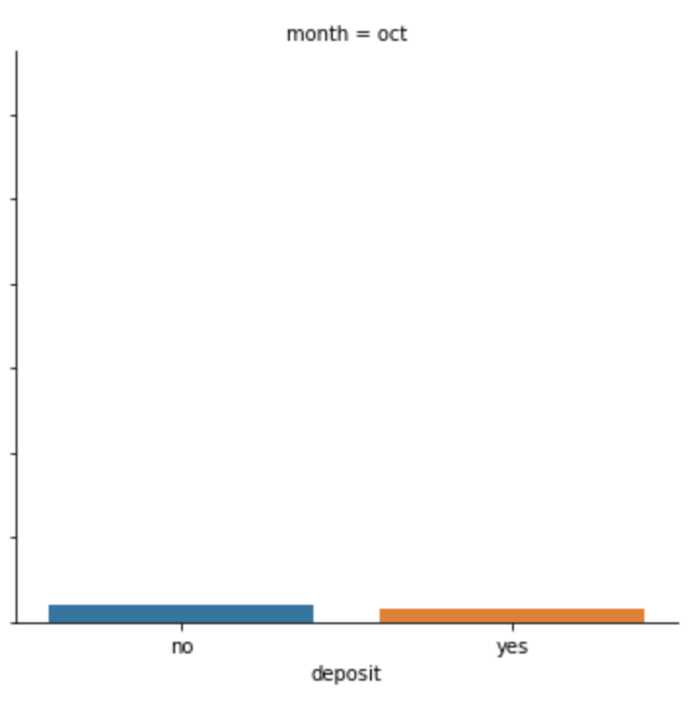
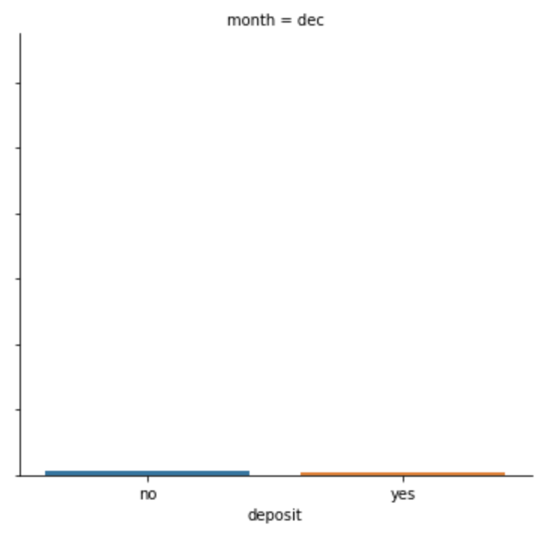
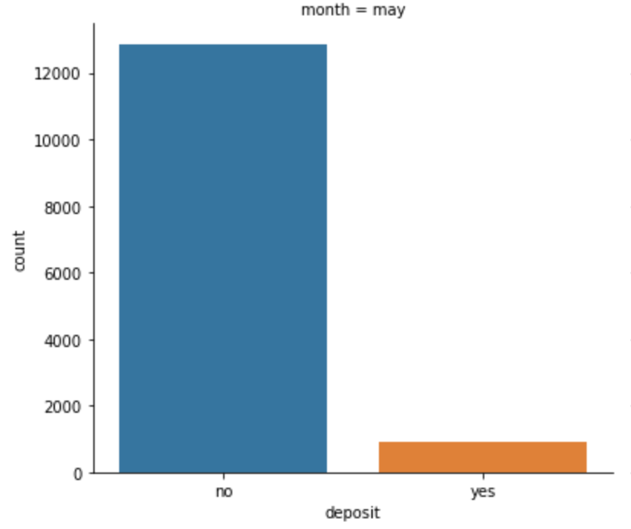
Which Job category is more interested in the term deposit?
Which period of the year does clients show more interest in the term deposit?
1300 clients with job (management) are more interested in the term deposit
Developing questions and extracting insights
Which month did the clients show the lowest interest?
In the month of may,records are high but clients interest ratio is very less
In month of March, September October and December client show high interest to deposit

Slide 5
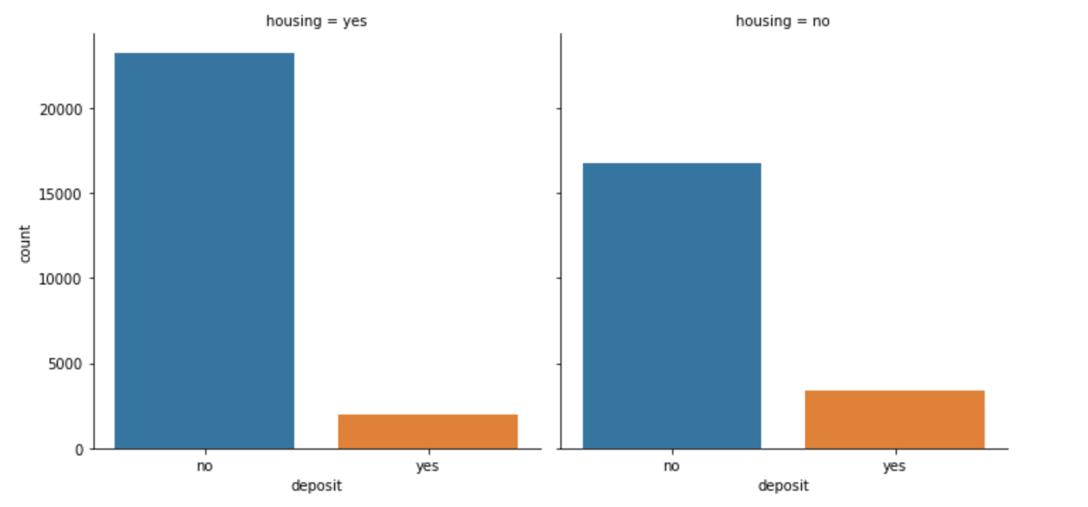
Are clients with housing loan interested in the term deposit?
Developing questions and extracting insights
Clients with no housing and personal loan are more interested in the term deposit as compared to the client with housing and personal loan

